Slide 1


Application Interface Enhancement: HealthPass
Seng474 – Term Project
Mesude Gökpınar 202028016
Duru Karacan 202128022
Hikmetcan Altaş 202011017

Slide 2
Table of Content
Team Structure
Purpose of the Test
Scope of the Test
Heuristics List with the number of the problems found
Findings of the heuristic evaluation
Recommendations

Slide 3
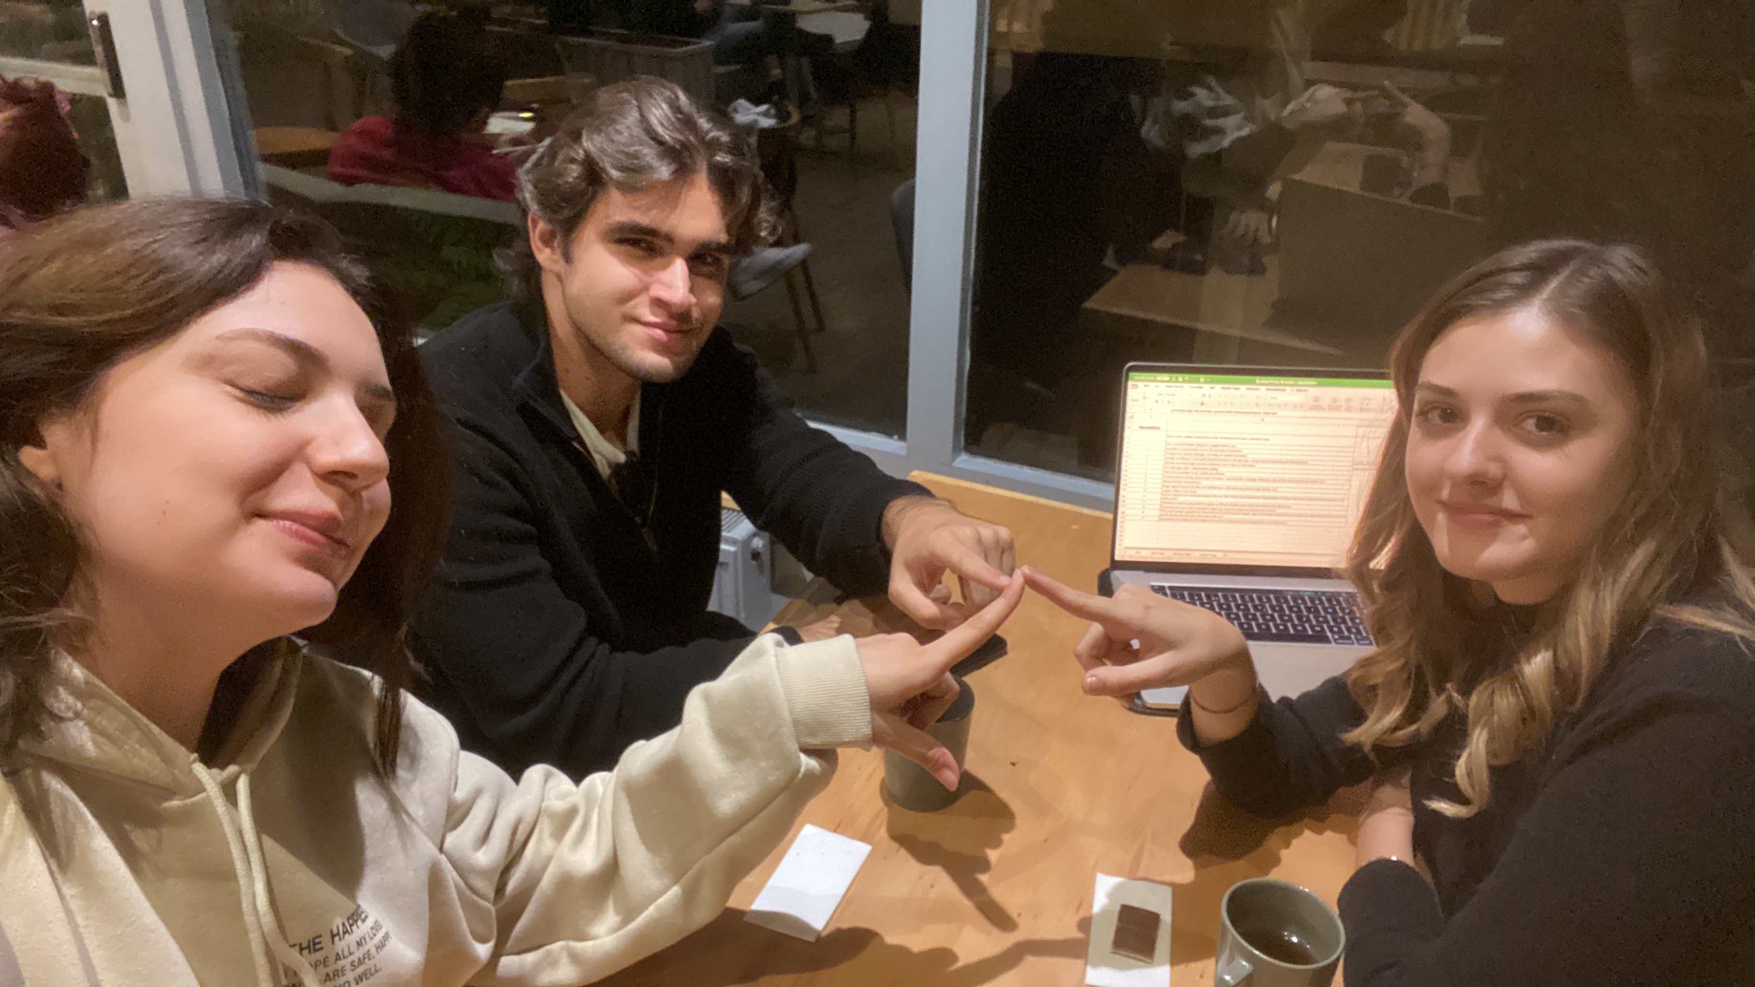
Team Structure
TEAM MDH
Our Team Name: MDH
Team Lead:
Mesude Gökpınar
- student of Software Engineering
Usability Tester:
Duru Karacan
- student of Software Engineering
Technical Analyst:
Hikmetcan Altaş
- student of Computer Engineering

Slide 4
Purpose of the Test
Objective:
The primary objective of this test is to analyze the user interface of the selected software using heuristic evaluation methods and identify usability issues.
Selected Software:
HealthPass is an application integrated with e-nabız, where you can store your vaccination, test and immunity certificates in accordance with international standards and use them easily while traveling.
Current/Potential Users:
The current and potential users are anyone who wants to check and report their health status while traveling.

Slide 5
Scope of the Test
Evaluated Pages:
We have chosen to evaluate the following pages within HealthPass
Welcome Page : Providing users with a welcoming message, it informs them about the basic functionalities of the application.
Digital Health Wallet Page : Allowing users to securely store and view health documents in their digital health wallets.
Adding Digital Health Certificate Page : Facilitating users in adding new health certificates using scan and add function with QR code and also integrating these documents into their digital health wallets.

Slide 6
Selection Rationale:
Welcome page is crucial as users' first touchpoint and providing vital information about basic functionalities.
Digital health wallet page provides a secure platform for users to store and access health documents digitally.
Adding digital health certificate page was chosen due to its pivotal role in HealthPass. Add new health certificates with a QR code scan and add function
We've chosen pages that give a full picture of how users interact with the software. Our goal is to spot any issues that might affect the user experience on these important pages.

Slide 7
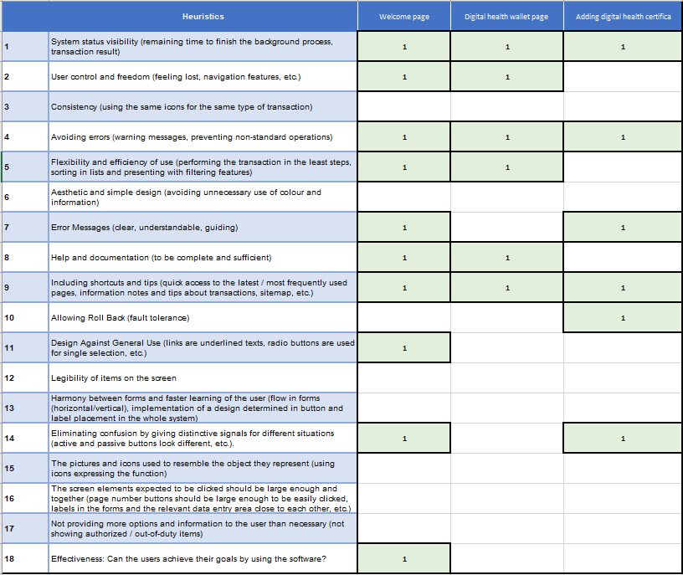
Heuristics List : # of the mistakes

Slide 8
Recommendations
The page lacks depth and does not contain hints to guide the user, making them feel lost.
There is no filtering; certificates are added to the application through E-nabız without a tab directing to E-nabız.
Despite aiming to be a user-friendly application for general use, the design falls short as the clickable elements are minimal.
The application's complexity arises from its simplicity and limited interaction with the user.
Selecting the desired document among certificates is not done in a minimum number of steps.
When scanning a non-functional QR code, it does not provide an error message indicating that it is invalid.
With the presence of more than three certificates, the interface becomes complicated, and users struggle to find what they are looking for.

Slide 9
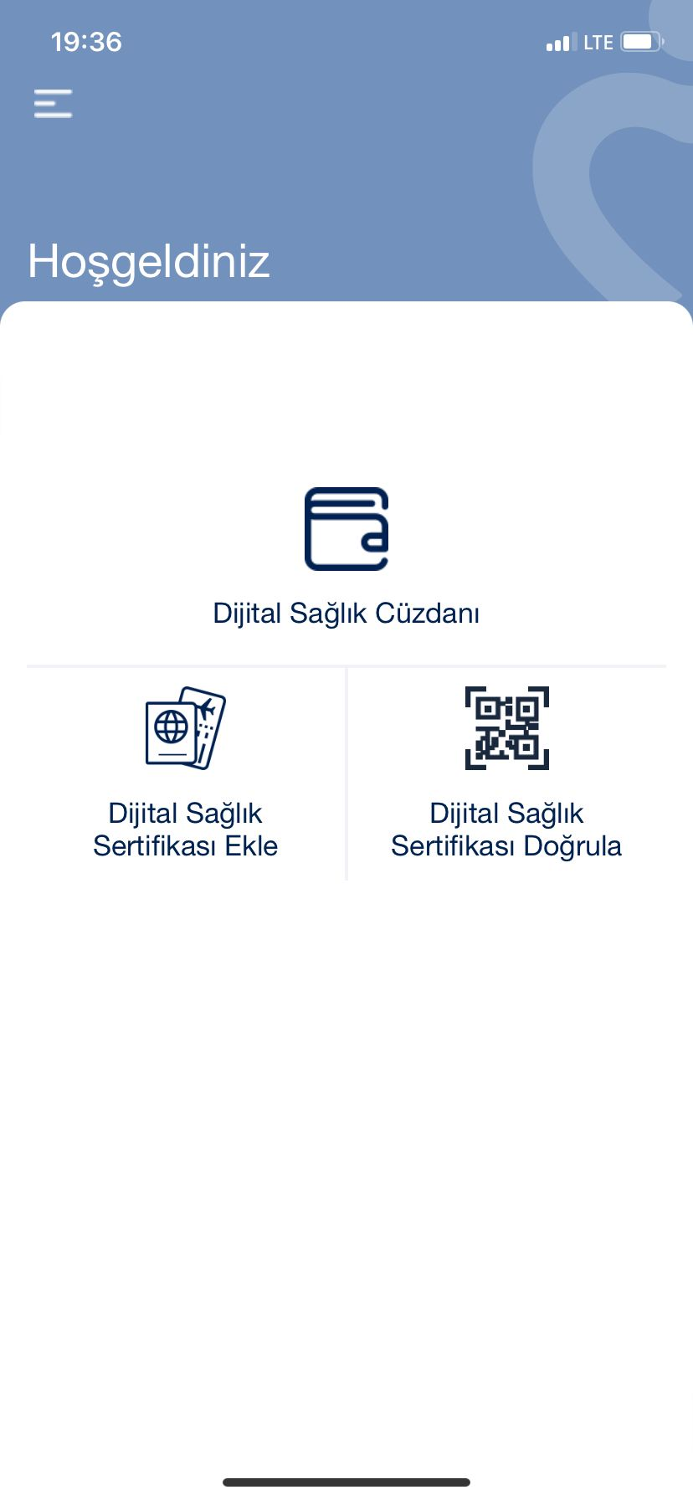
Our Rec. for welcome page:
A user session is not created; a user profile can be established, encouraging the user to adopt the application.
A scrolling agenda box can be added to the homepage to inform users about the health certificates they need to have when visiting different countries, and a search box can be included for research purposes.
A Wallet section can be added, which can also include travel tickets, eliminating the need for the user to go to a different application for tickets.
For easy navigation at the bottom of the page, home, favorite, and back buttons can be added.

Slide 10
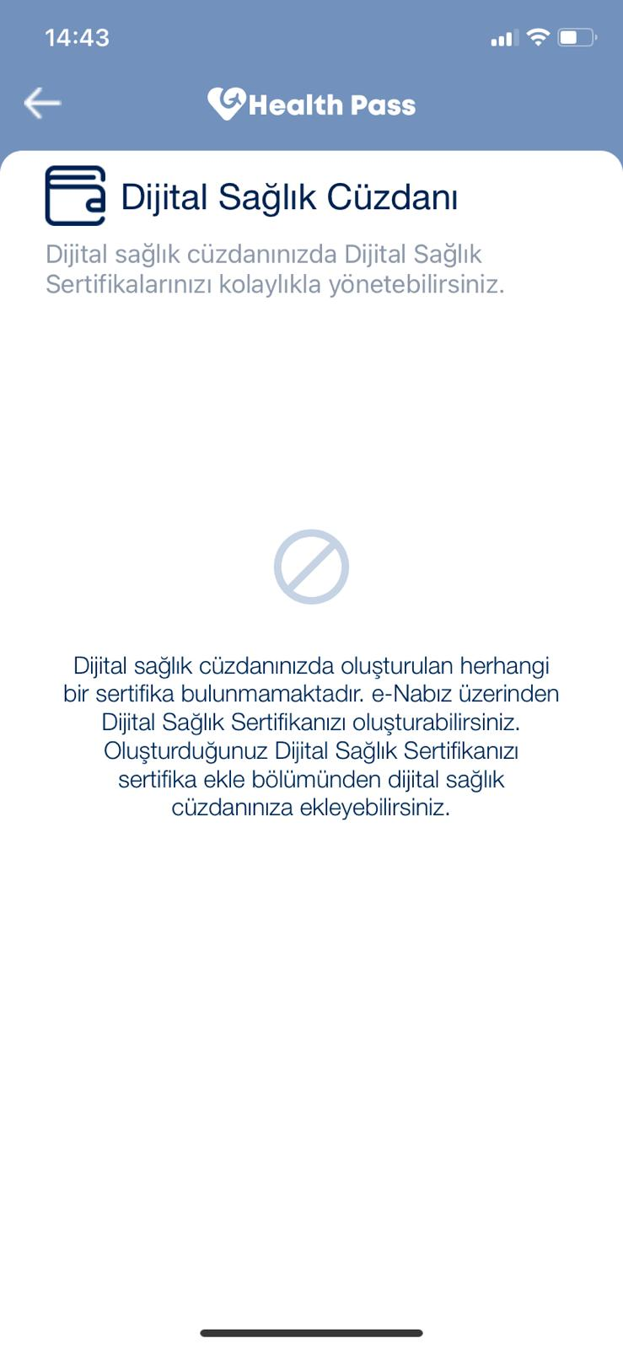
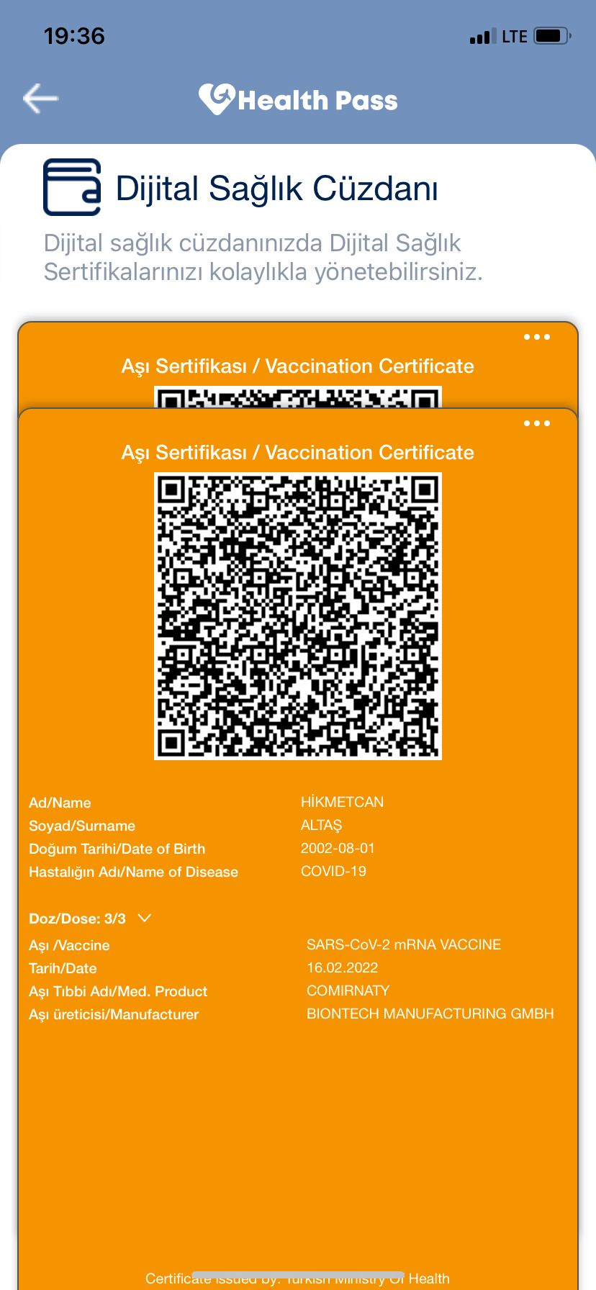
Our Rec. for digital health wallet screen:
When entering the page, it mentions the ability to add certificates via e-Nabız, but there is no link or clickable area directing to e-Nabız. To further streamline this process, an "Connect with e-Nabız" extension can be added, allowing users to import certificates without hassle.
After adding certificates, selecting and checking them becomes challenging, especially when multiple categories of certificates are added. To address this issue, a filtering and sorting section should be placed above to make it easier to find the desired certificate when multiple categories are present. Additionally, to facilitate the direct selection of the desired certificate, different listing options for certificates should be introduced.
At the bottom of the page, home, favorite, and back buttons can be added for easy navigation.

Slide 11
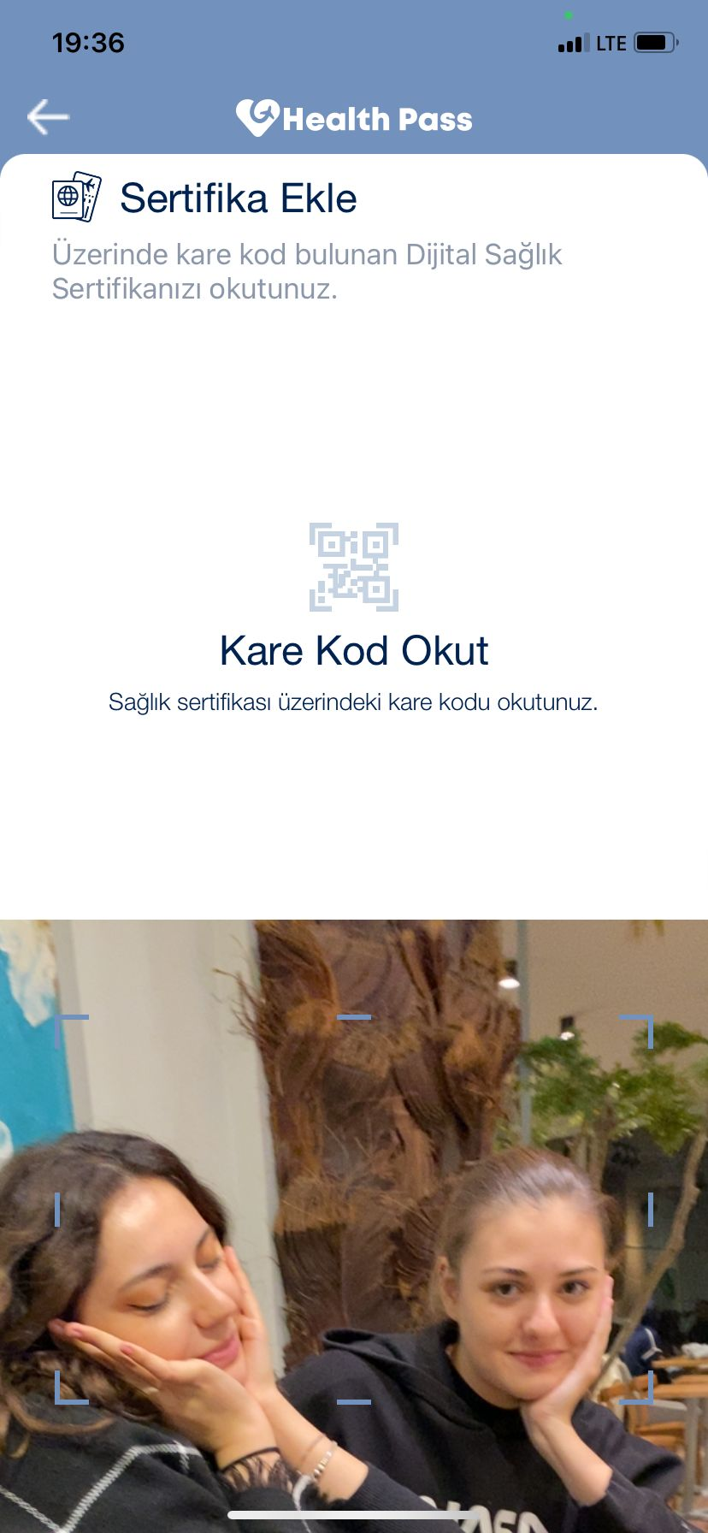
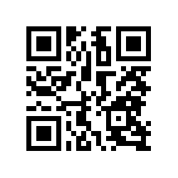
Our Rec. for Scanning Sertificate:
There is no warning when the QR code is incorrect or invalid while scanning. A prompt for such cases can be quickly implemented to provide feedback.
Similarly, when adding a certificate here, a few alternative options to the QR code can be included (such as a written encrypted version of the QR code).
A button for e-Nabız can also be added here.
For easy navigation at the bottom of the page, home, favorite, and back buttons can be included.

Slide 12
THANKS!

